Slide 1
Spring Batch 2.0 Overview

Slide 2
Agenda
Spring Batch Overview
Domain Language of Batch
Configuring and Running a Job
Miscellaneous
Data are always
part of the game.
Summary

Slide 3
Spring Batch Introduction
Spring Batch is the first java based framework for batch processing
a lightweight, comprehensive batch framework
builds upon the productivity, POJO-based development approach, known from the Spring Framework current GA release is 1.1.4.RELEASE
Spring Batch 2.0 will be released in the next couple of months
Presentation is based on 2.0.0-RC1

Slide 4
Batch Processing
What is a Batch Application?
Batch applications need to process high volume business critical transactional data
A typical batch program generally
1. reads a large number of records from a database, file, or queue
2. processes the data in some fashion, and
3. then writes back data in a modified form

Slide 5
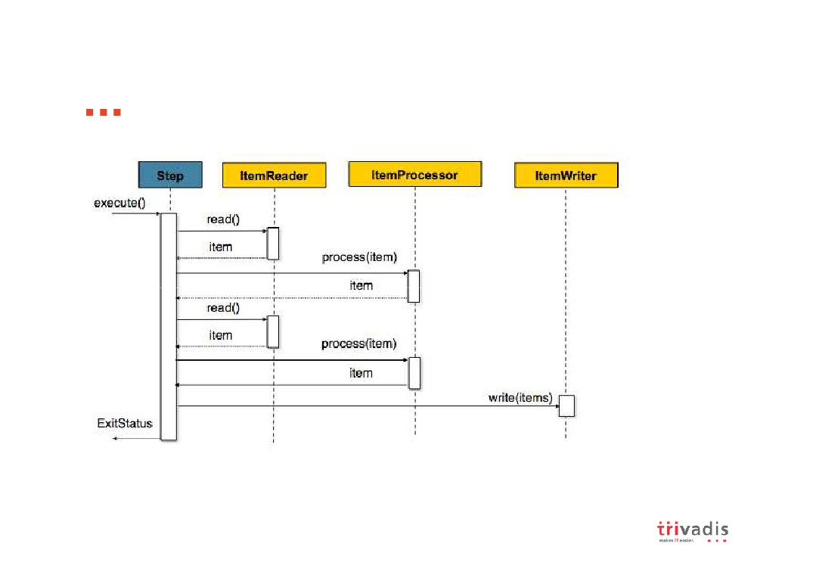
Item Oriented Processing

Slide 6
Usage Scenarios
Commit batch process periodically
Concurrent batch processing: parallel processing of a job Staged, enterprise message-driven processing Massively parallel batch processing Manual or scheduled restart after failure
Sequential processing of dependent steps (with extensions to workflow-driven batches)
Partial processing: skip records (e.g. on rollback)
Whole-batch transaction: for cases with a small batch size or existing stored procedures/scripts

Slide 7
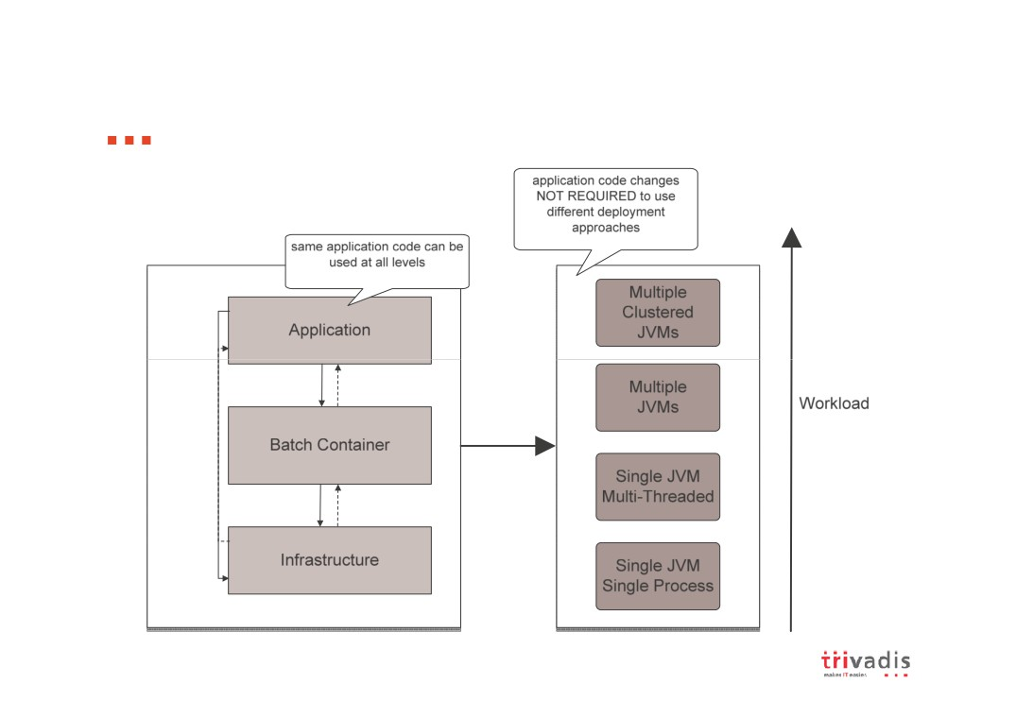
Spring Batch: Layered Architecture

Slide 8
Agenda
Spring Batch Overview
Domain Language of Batch
Configuring and Running a Job
Miscellaneous
Data are always
part of the game.
Summary

Slide 9
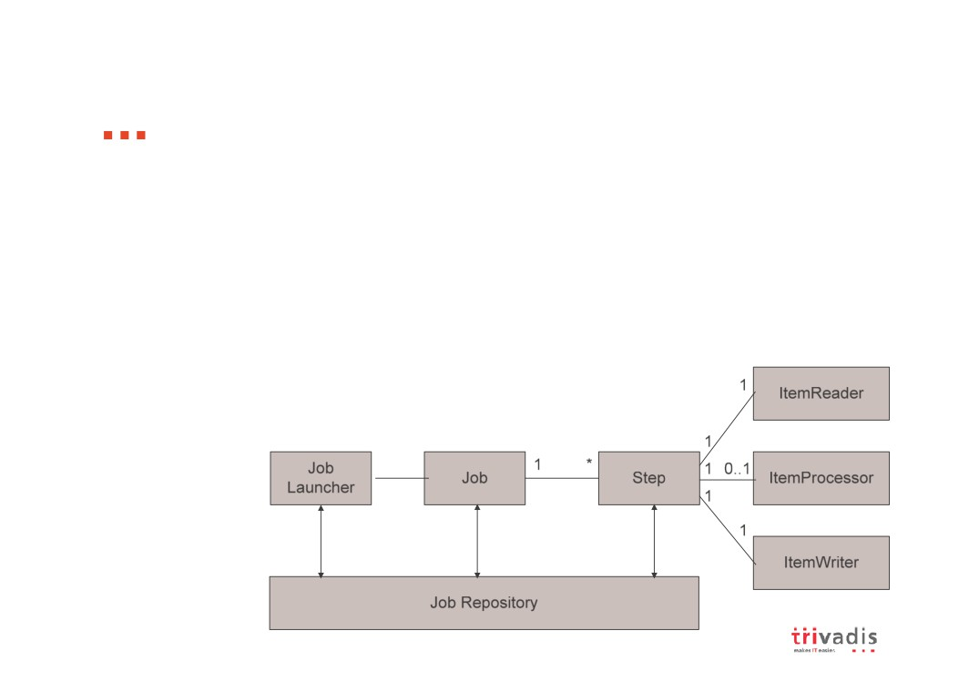
Domain Language of Batch
A job has one to many steps
A step has exactly one ItemReader, ItemWriter and optionally an ItemProcessor
A job needs to be launched (JobLauncher)
Meta data about the running process needs to be stored (JobRepository)

Slide 10
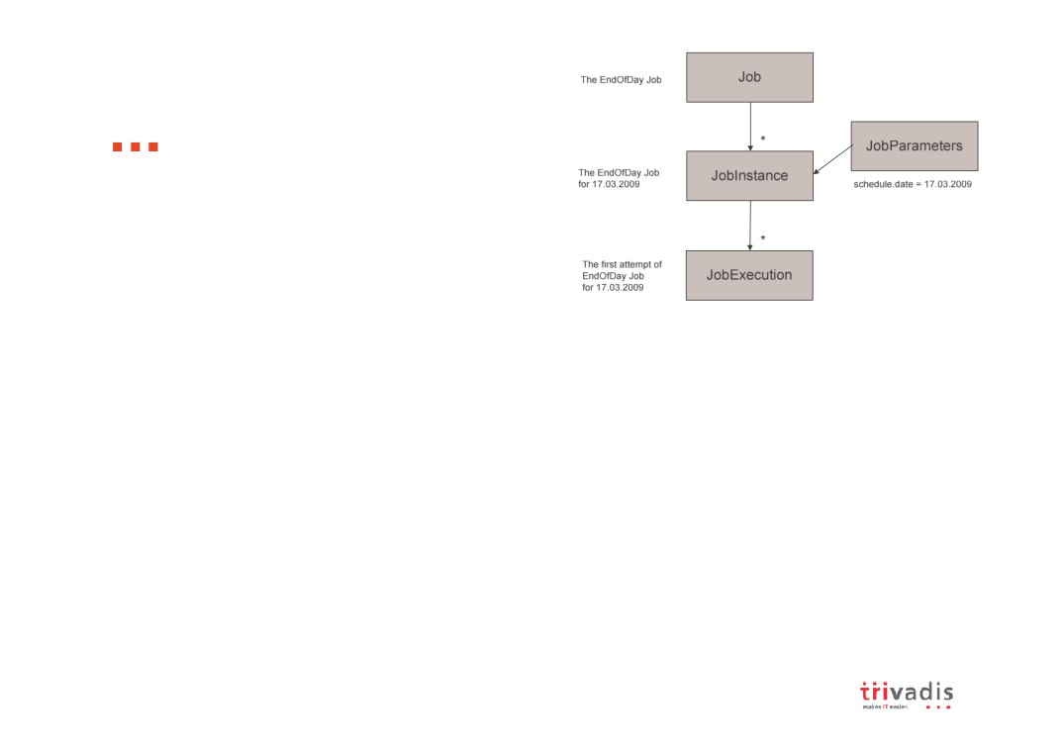
Domain Language of Batch
Job
encapsulates an entire batch process
Job Instance
refers to the concept of a logical job run
job running once at end of day, will have one logical JobInstance per day each JobInstance can have multiple executions
Job Execution
refers to the technical concept of a single attempt to run a Job
An execution may end in failure or success, but the JobInstance
will not be considered complete unless the execution completes successfully
Job Parameters
is a set of parameters used to start a batch job JobInstance = Job + JobParameters

Slide 11
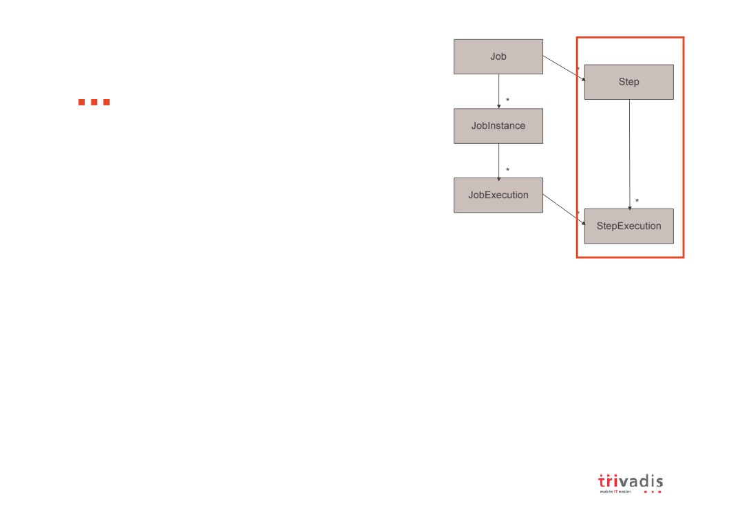
Domain Language of Batch
Step
a domain object that encapsulates an
independent, sequential phase of a batch job
can be as simple or complex as the developer desires
Step Execution
represents a single attempt to execute a Step
A new StepExecution will be created each time a Step is run, similar to JobExecution
A StepExecution will only be created when its Step is actually started

Slide 12
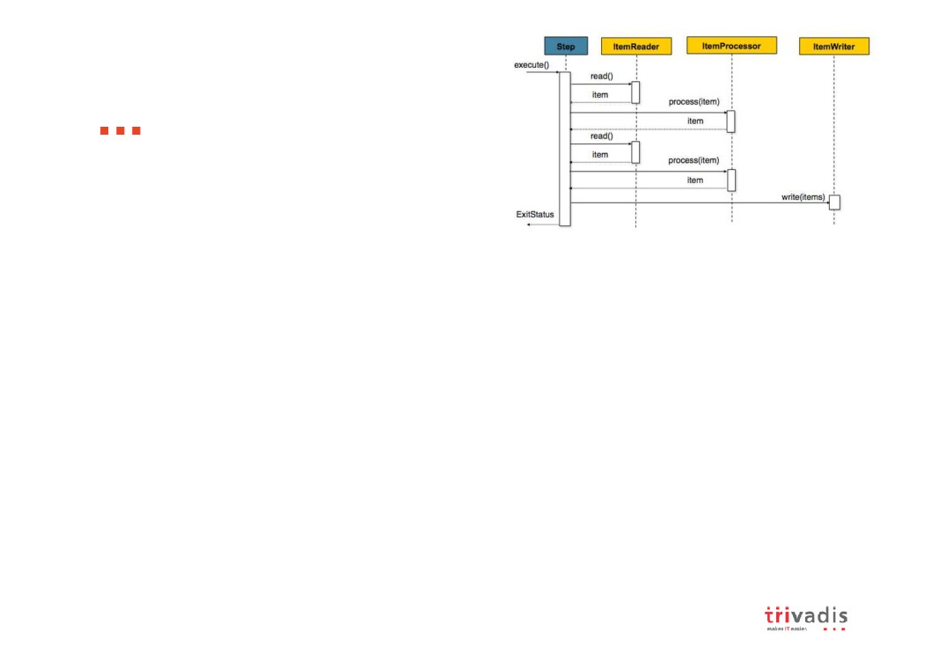
Domain Language of Batch
Item Reader
an abstraction that represents the retrieval of input for a Step
one item at a time
When it has exhausted the items it can provide, it will indicate this by returning null
Various implementation available out-of-the-box
Item Writer
an abstraction that represents the output of a Step
Chunk-oriented processing
Generally, an item writer has no knowledge of the input it will receive next Various implementation available out-of-the-box
Item Processor
an abstraction that represents the business processing of an item provides access to transform or apply other business processing returning null indicates that the item should not be written out

Slide 13

Domain Language of Batch
ItemReader
public interface ItemReader<T> {
T read() throws Exception, UnexpectedInputException, ParseException;
}
ItemWriter
public interface ItemWriter<T> {
void write(List<? extends T> items) throws Exception; }
ItemProcessor
public interface ItemProcessor<I, O> { O process(I item) throws Exception; }

Slide 14

Domain Language of Batch
Job Repository
the persistence mechanism for all of the Stereotypes
provides CRUD operations for JobLauncher, Job, and Step implementations
Job Launcher
represents a simple interface for launching a Job with a given set of
JobParameters
public interface JobLauncher {
public JobExecution run(Job job,
JobParameters jobParameters)
throws JobExecutionAlreadyRunningException, JobRestartException;
}

Slide 15
Agenda
Spring Batch Overview
Domain Language of Batch
Configuring and Running a Job
Miscellaneous
Data are always
part of the game.
Summary

Slide 16
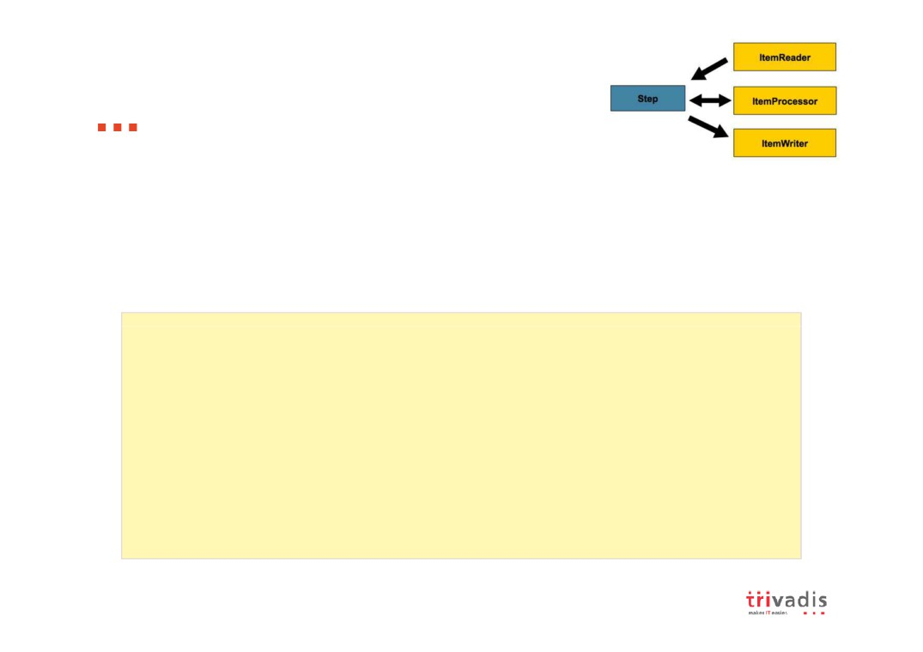
Configuring and Running a Job
Configuring a Job and its steps
There are multiple implementations of the Job interface, however, the namespace abstracts away the differences in configuration It has only three required dependencies: a name, JobRepository, and a list of Steps
<job id="sampleJob">
<step id="step1" job-repository="jobRepository" transaction-manager="transactionManager">
<tasklet reader="itemReader" writer="itemWriter" commit-interval="10"/>
</step>
</job>
<bean id="itemReader" ...> <bean id="itemWriter" ...>

Slide 17

Configuring and Running a Job
Configuring a Job Repository
used for basic CRUD operations of the various persisted domain objects such as JobExecution and StepExecution
batch namespace abstracts away many of the implementation details
<job-repository id="jobRepository"
dataSource="dataSource"
transactionManager="transactionManager"
isolation-level-for-create="serializable" table-prefix="BATCH_" />
Configuring a Job Launcher
<bean id="jobLauncher"
class="...batch.execution.launch.SimpleJobLauncher"> <property name="jobRepository" ref="jobRepository" /> </bean>

Slide 18
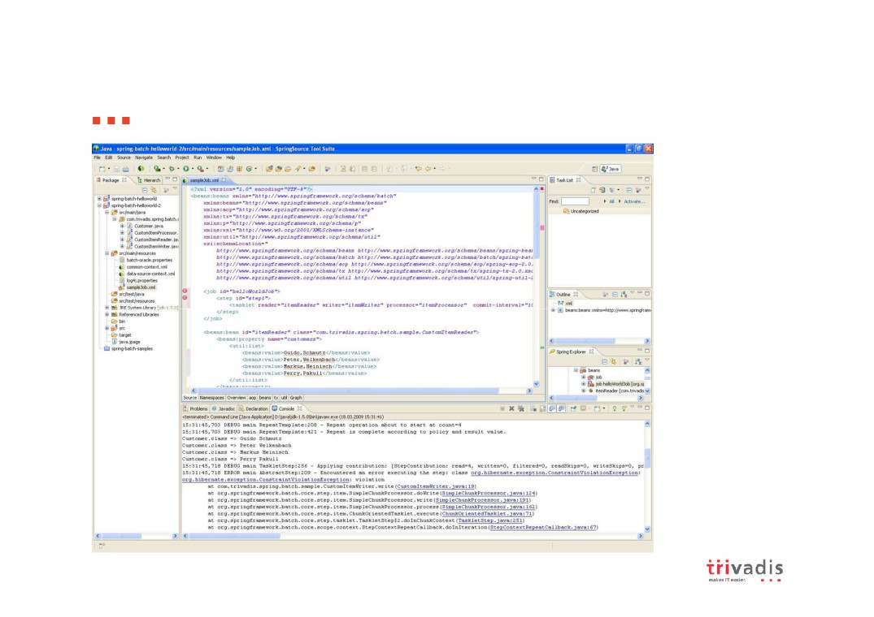
Demo

Slide 19
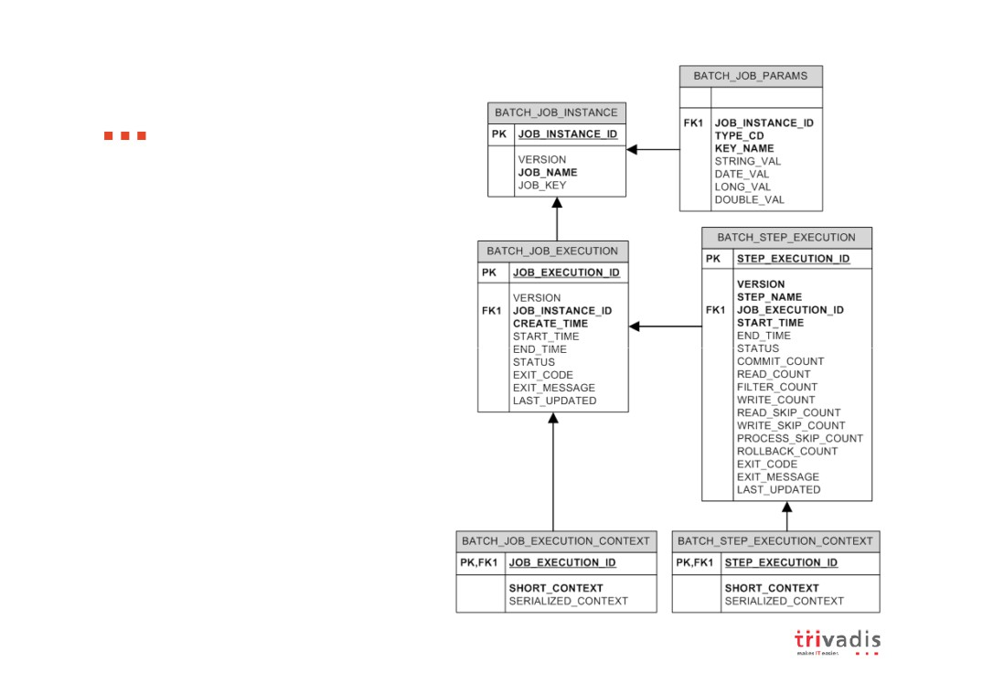
Meta-Data Schema
The Spring Batch Meta-Data tables very closely match the Domain objects that
represent them in Java

Slide 20
Agenda
Spring Batch Overview
Domain Language of Batch
Configuring and Running a Job
Miscellaneous
Data are always
part of the game.
Summary

Slide 21
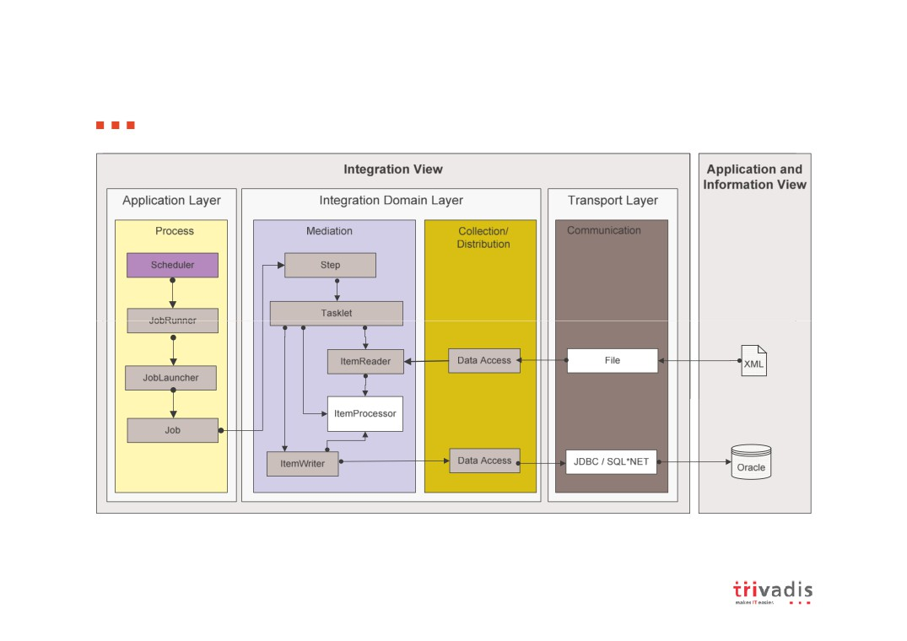
Spring Batch in Trivadis Integration Architecture Blueprint

Slide 22
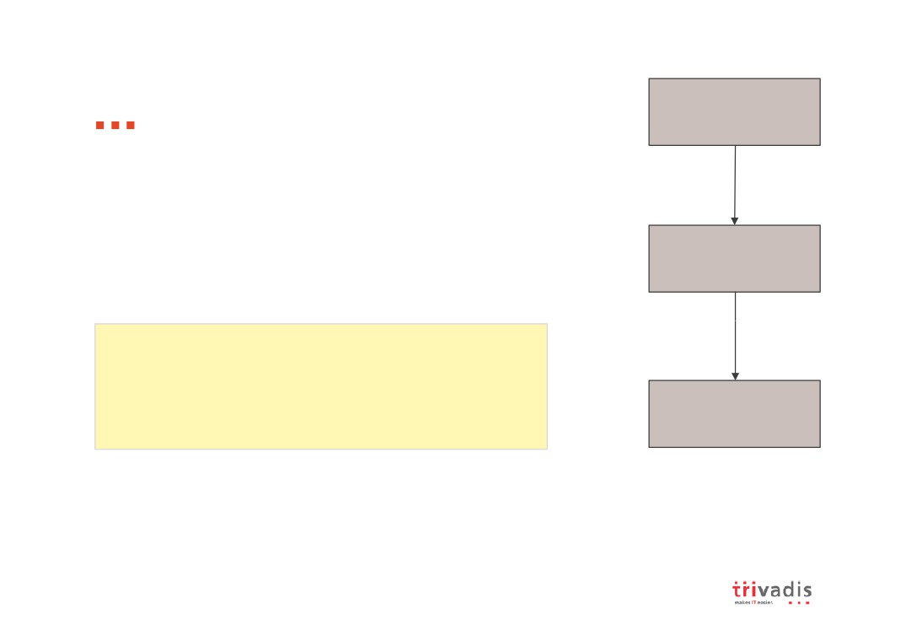
Sequential Flow
Step A
The simplest flow scenario is a job where all of the steps execute sequentially
This can be achieved using the 'next' attribute of the step element
Step B
<job id="job">
<step id="stepA" next="stepB" /> <step id="stepB" next="stepC"/> <step id="stepC"/>
Step C
</job>

Slide 23
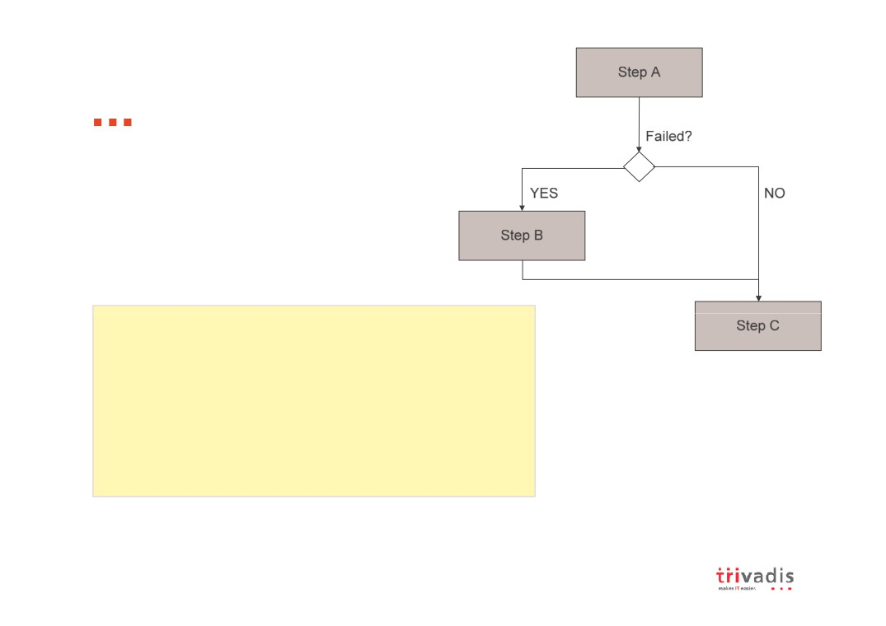
Conditional Flow
In order to handle more complex scenarios, Spring Batch allows transition elements to be defined within the step element
<job id="job">
<step id="stepA">
<next on="FAILED" to="stepB" /> <next on="*" to="stepC" /> </step>
<step id="stepB" next="stepC" /> <step id="stepC" />
</job>

Slide 24
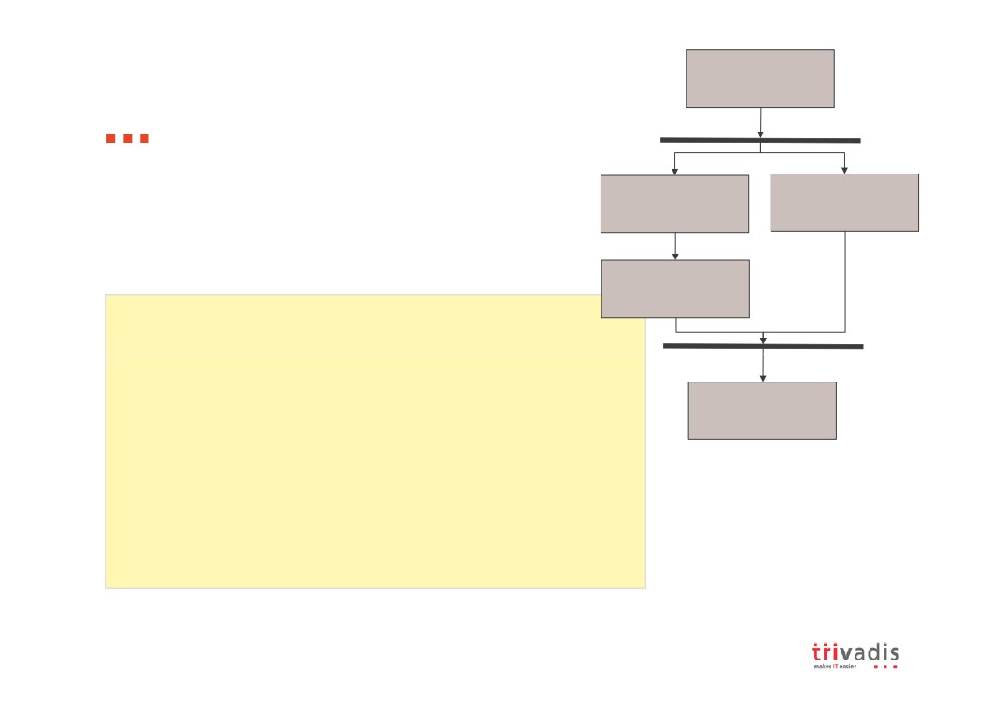
Step A
Split Flow
Spring Batch also allows for a job to be configured with parallel flows using the 'split' element
Step B11
Step B21
Step B12
<step id="stepA" next="stepB"/> <split id="stepB" next="stepC"> <flow>
<step id="stepB11" next="stepB11"/> <step id="stepB12"/>
Step C
</flow>
<flow>
<step id="stepB21"/> </flow>
</split>
<step id="stepC"/>

Slide 25

Restartablility
The launching of a Job is considered to be a 'restart' if a
JobExecution already exists for the particular JobInstance.
Ideally, all jobs should be able to start up where they left off but there are scenarios where this is not possible
If a Job should never be restarted, but should always be run as part of a new JobInstance, then the restartable property may be set to 'false‘
<job id="footballJob" restartable="false">
<step id="playerload" next="gameLoad"/>
<step id="gameLoad" next="playerSummarization"/> <step id="playerSummarization"/>
</job>

Slide 26

Configuring a Step for Restart
Setting a StartLimit
control the number of times a Step may be started
<step id="step1">
<tasklet reader="itemReader" writer="itemWriter" commit-interval="10" start-limit="1"/> </step>
Restarting a completed step
In a restartable job, one or more steps should always be run, regardless of whether or not they were successful the first time
<step id="step1">
<tasklet reader="itemReader" writer="itemWriter" commit-interval="10"
allow-start-if-complete="true"/> </step>

Slide 27

Configuring Skip Logic
there are scenarios where errors encountered should not result in Step failure, but should be skipped instead
<step id="step1">
<tasklet reader="flatFileItemReader"
writer="itemWriter" commit-interval="10" skip-limit="10">
<skippable-exception-classes>
org.springframework.batch.item.file.FlatFileParseExcept ion
</skippable-exception-classes>
</tasklet>
</step>

Slide 28

Configuring Fatal Exceptions
it may be easier to identify which exceptions should cause failure and skip everything else
<step id="step1">
<tasklet reader="flatFileItemReader"
writer="itemWriter" commit-interval="10" skip-limit="10">
<skippable-exception-classes> java.lang.Exception
</skippable-exception-classes> <fatal-exception-classes> java.io.FileNotFoundException </fatal-exception-classes>
</tasklet>
</step>

Slide 29

Intercepting Step Execution
You might need to perform some functionality at certain events during the execution of a Step
<step id="step1">
<tasklet reader="reader" writer="writer" commit-interval="10"/>
<listeners>
<listener ref="stepListener"/> </listeners>
</step>
can be accomplished with one of many Step scoped listeners, like
StepExecutionListener
ChunkListener
ItemReadListener
ItemProcessListener ItemWriteListener SkipListener

Slide 30
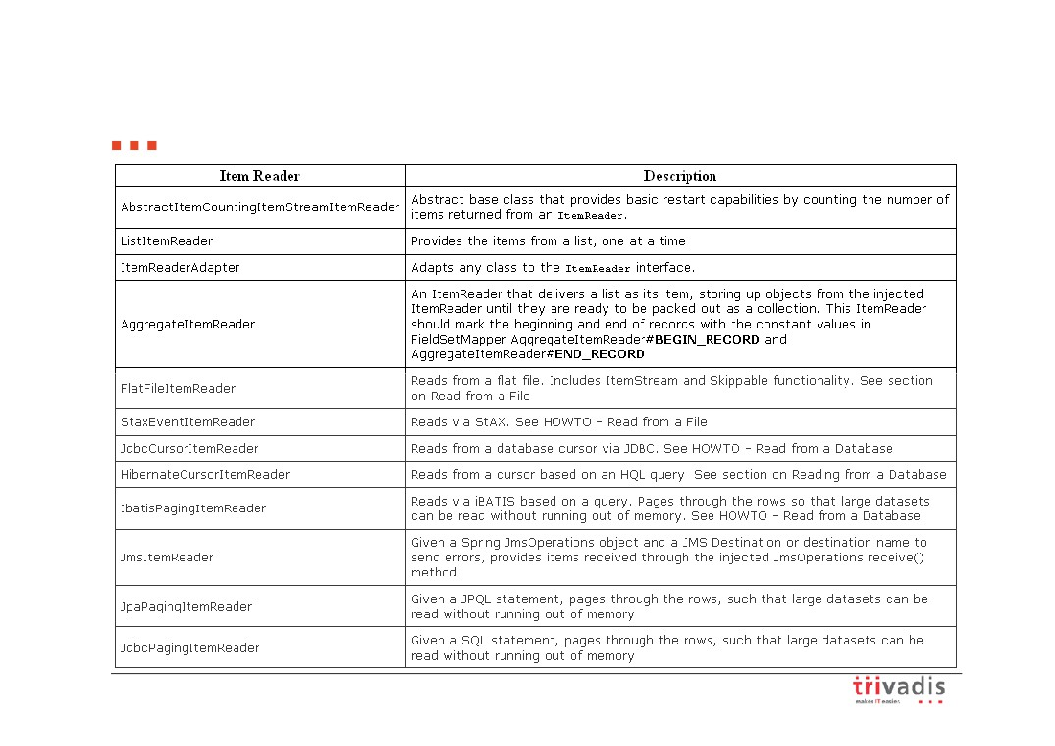
Available Item Readers

Slide 31
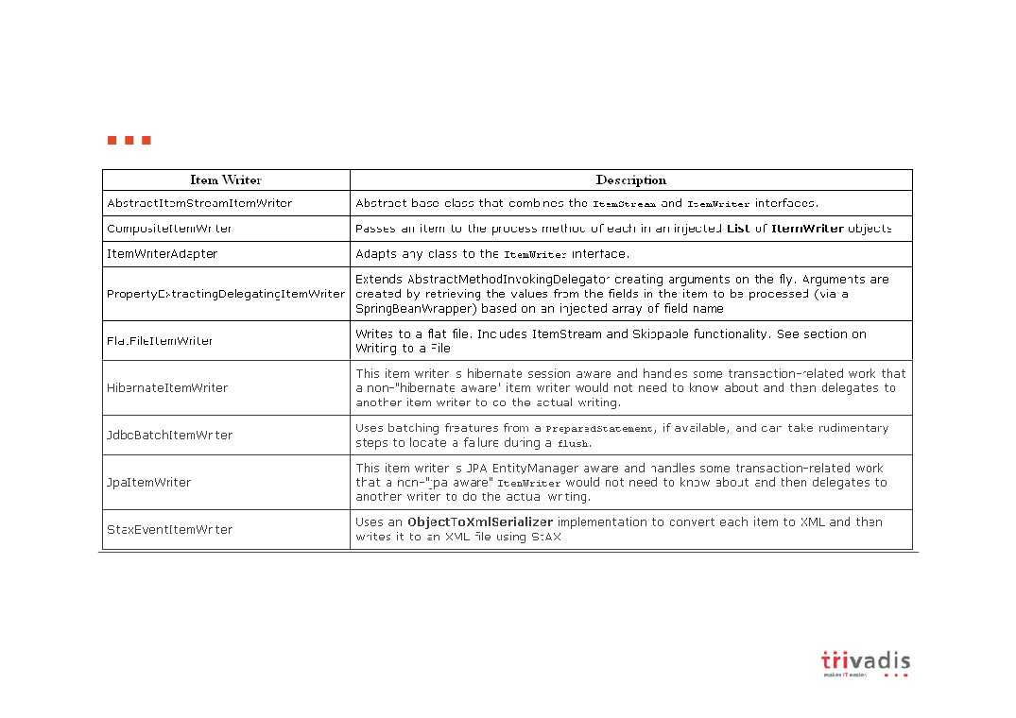
Available Item Writers

Slide 32
Agenda
Spring Batch Overview
Domain Language of Batch
Configuring and Running a Job
Miscellaneous
Data are always
part of the game.
Summary

Slide 33

Summary
Lack of a standard enterprise batch architecture is resulting in
higher costs associated with the quality and delivery of solutions.
Spring Batch provides a highly scalable, easy-to-use,
customizable, industry-accepted batch framework collaboratively developed by Accenture and SpringSource
Spring patterns and practices have been leveraged allowing
developers to focus on business logic, while enterprise architects can customize and extend architecture concerns

Slide 34
Thank you!

Slide 35
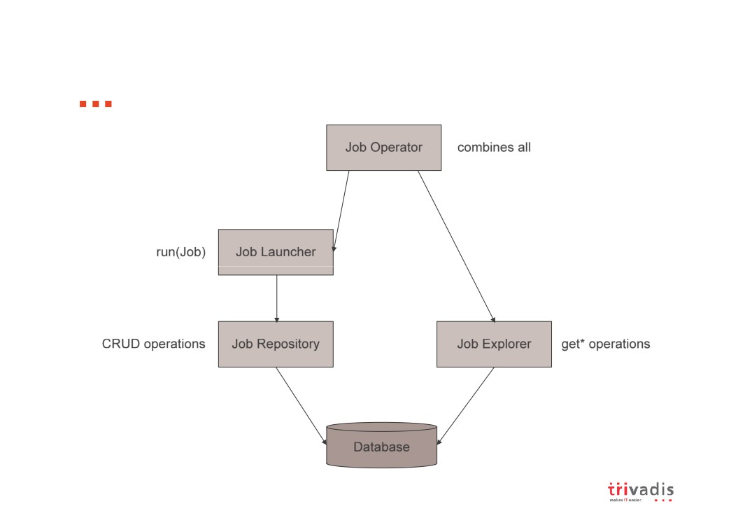

Slide 36
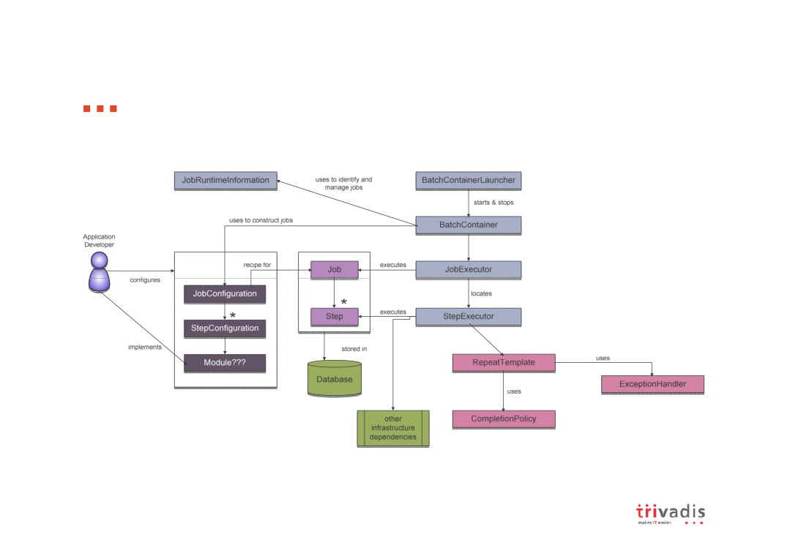

Slide 37
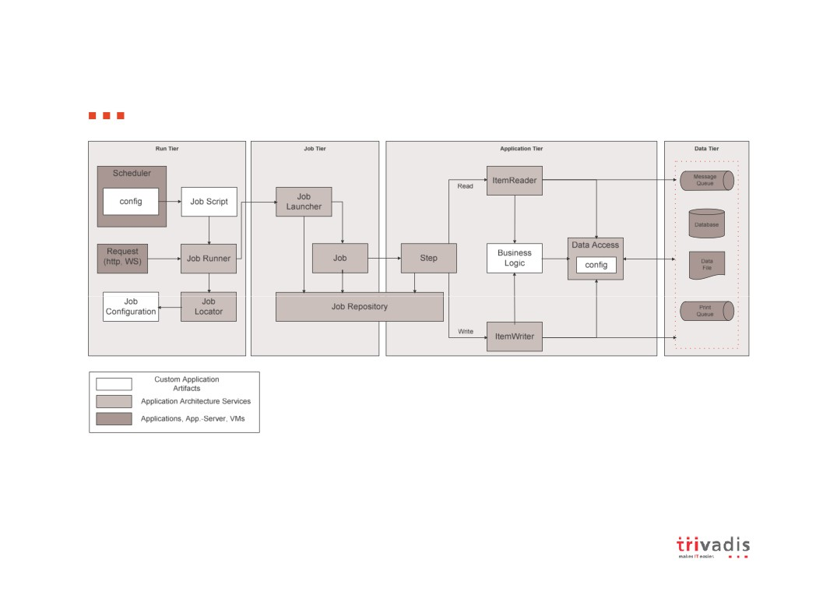
Spring Batch Launch Environment

Slide 38
Spring Batch Launch Environment
Run Tier
concerned with the scheduling and launching of the application a vendor product is typically used in this tier to allow
time-based and interdependent scheduling of batch jobs
providing parallel processing capabilities
Job Tier
responsible for the overall execution of a batch job
sequentially executes batch steps, ensuring that all steps are in the correct state and all appropriate policies are enforced
Application Tier
contains components required to execute the program
contains specific modules that address the required batch functionality and enforces policies around a module execution (e.g., commit intervals, capture of statistics, etc.)
Data Tier
provides the integration with the physical data sources that might include databases, files, or queues.

Slide 39
Spring Batch features introduced by the import catalog job

Slide 40
The main components of a Spring Batch application

Slide 41
Running job instances and job executions
THE JOB, JOB INSTANCE, AND JOB EXECUTION

Slide 42
Spring Batch XML features
Main tags in Spring Batch XML

Slide 43
Configuring jobs

Slide 44
Configuring steps

Slide 45
Configuring tasklets and chunks

Slide 46
TASKLET

Slide 47
CHUNK-ORIENTED TASKLET
Chunk attributes

Slide 48
Chunk attributes

Slide 49
Chunk child elements

Slide 50
Additional chunk child elements
Additional chunk child elements (continued)

Slide 51
Specifying job repository parameters

Slide 52
Leveraging SpEL

Slide 53
Listeners

Slide 54
STEP LISTENERS

Slide 55
REPEAT AND RETRY LISTENERS

Slide 56
Common Attributes

